Slide 1

Apache Spark Datasets
CS 4981 ML Production Systems
RJ Nowling

Slide 2
Apache Spark
In-memory, stateful, distributed computing framework
Started by Matei Zaharia and other Ph.D. students at UC Berkeley in 2009
Open-sourced in 2010, donated to the Apache Foundation in 2013
Provides a local collections API that allows programmers to write programs that are very similar to something running on their local machine
We're going to look at examples of using the Dataset API to write programs for data processing

Slide 3
Spark Architecture
Spark Worker
Application Driver
Spark Master
Spark Worker
Spark Worker

Slide 4
Overview of Spark Driver Workflow
Create a Spark session
Read one or more data sets from a remote data source
Perform various transformations and analyses
Write the resulting data sets to a remote data source
Stop the Spark session

Slide 5
SparkSession Object
Manages the overall state of the Spark application:
connection to the Spark master process
creation of distributed collections
execution of the pipelines
All Spark applications
start by creating a SparkSession object
end by calling stop() on the object

Slide 6
SparkSession Object
val spark = SparkSession
.builder
// set number of cores to use in []
.master("local[4]")
.appName("DataFrameExample")
.getOrCreate()

Slide 7
Logging
Spark performs a LOT of logging
This can make it difficult to see any output generated by the program
Logging can be reduced by:
spark.sparkContext.setLogLevel("ERROR")

Slide 8
Implicits
Scala provides a way to add methods to existing objects through a system called "implicits"
It's effectively black magic
The important part you need to know is that you should add this import statement after creating your Spark session: import spark.implicits._

Slide 9
Reading Data and Creating a Dataset
val documents: Dataset[String] = spark.read
// read each file as a string instead of each line as a string
.option("wholetext", true)
.textFile("20news-18828/comp.graphics",
"20news-18828/comp.os.ms-windows.misc",
"20news-18828/comp.sys.ibm.pc.hardware",
"20news-18828/comp.sys.mac.hardware")

Slide 10
Spark Architecture (Loading Data)
Spark Worker
read()
Application Driver
Spark Master
Spark Worker
Spark Worker

Slide 11
Spark Architecture (Loading Data)
Spark Worker
read()
Application Driver
Spark Master
Spark Worker
Data
Source
Spark Worker

Slide 12
Spark Architecture (Loading Data)
Spark Worker
read()
Application Driver
Spark Master
Spark Worker
Data
Source
Spark Worker

Slide 13
Spark Architecture (Loading Data)
Spark Worker
Partition
read()
Partition
Application Driver
Spark Master
Spark Worker
Partition
Data
Source
Partition
Spark Worker
Partition
Partition

Slide 14
Spark Architecture (Loading Data)
Spark Worker
Partition
Dataset object
Partition
Application Driver
Spark Master
Spark Worker
Partition
Data
Source
Partition
Spark Worker
Partition
Partition

Slide 15
Datasets as Distributed Collections
Datasets are distributed collections
Data are organized into partitions
Partitions are placed on the machines in a cluster
The collection is modeled by a Dataset object created in the driver
The collection API allows the programmer to manipulate the data in a manner similar to any local collection (e.g., Java collection)
But the actual computation is performed on the cluster machines

Slide 16
Datasets are Immutable
The objects are stored in a serialized format to reduce memory usage
When objects are deserialized for transformations, the result is a copy
Transformations operate on the copies
A new Dataset is creating that contains the modified objects

Slide 17
Immutability: Advantages
Helps to reduce bugs (avoids unintended changes)
Allows Datasets to be reused: two sets of transformations can be applied to the same Dataset
Fault tolerance:
if a node crashes, Spark has the history of where the data originated and all transformations
Spark will reconstruct the objects

Slide 18
Dataset Operations are Lazy
Datasets queue up data loading and transformations
The queued transformations are not executed until an action is requested
If an action is never called, the transformations will never be executed
You can think of the end of the actions as "pulling" the calculations forward

Slide 19
Laziness Enables Optimizations
Transformations can be merged into a single pass to reduce overhead
Objects stored in the collection are serialized into a more memory efficient format
Perform (de)serialization once for a group of transformations rather than for each transformation
Operations may be re-ordered (when safe) to make them more efficient
Move a filter() operation before a map() operation so that the map() is applied to fewer items

Slide 20
Transformation: Map
map(func: T => U) Runs the given function on each object and returns a new Dataset with the outputs
Assume allWords = Dataset("frog", "dog", "human")
val wordLengths = allWords.map(word => word.length)
wordLengths = Dataset(4, 3, 5)

Slide 21
Transformation: Flat Map
flatMap(func: T => Iterator[U]) Runs the given function on each object. It is expected that the function returns an iterator. All of the items in each iterator are added and returned as a new Dataset.
// Assume lists = DataSet((1, 4), (5, 7), (8, 12))
val numbers = lists.flatMap(pair => pair._1 to pair._2)
// numbers = DataSet(1, 2, 3, 4, 5, 6, 7, 8, 9, 10, 11, 12)

Slide 22
Transformation: Filter
filter(func: T => Boolean) Returns a new Dataset containing objects for which the function returns true
// Assume allNumbers = Dataset(1, 2, 3, 4, 5, 6)
val oddNumbers = allNumbers.filter(n => n % 2 == 1)
// oddNumbers = Dataset(1, 3, 5)
val evenNumbers = allNumbers.filter(n => n % 2 == 0)
// evenNumbers = DataSet(2, 4, 6)

Slide 23
Transformation: Distinct
distinct() Returns a new Dataset containing only the distinct objects in this Dataset. In other words, it removes duplicates.
// Assume allWords = Dataset("cat", "dog", "frog", "dog", "cat")
val uniqueWords = allWords.distinct()
// uniqueWords = Dataset("cat", "dog", "frog")

Slide 24
Transformation: Union
union(other: Dataset) combines this Dataset with a second Dataset and returns as a new Dataset.
// Assume commonPets = Dataset("cat", "dog", "bird", "frog")
// Assume uncommonPets = Dataset("frog", "iguana", "horse")
val pets = commonPets.union(uncommonPets)
// pets = Dataset("cat", "dog", "bird", "frog", "frog", "iguana", "horse")

Slide 25
Transformation: Intersect
intersect(other: Dataset) returns a new Dataset with all objects that appear in both input Datasets.
// Assume commonPets = Dataset("cat", "dog", "bird", "frog")
// Assume uncommonPets = Dataset("frog", "iguana", "horse")
val pets = commonPets.intersect(uncommonPets)
// pets = Dataset("frog")

Slide 26
Actions (Collect)
Transfers to the Dataset to the driver application
collect(): Array[T]
collectAsList(): List[T]
Don't do this unless you've substantially reduced the Dataset size through transformations

Slide 27
Actions (Inspecting the Data)
These methods allow you to inspect your Datasets
count(): Long – return the number of objects
head(int n): Array[T] – transfer the first n objects to the driver
tail(int n): Array[T] – transfer the last n objects to the driver
These are very useful for getting a sense if data are read correctly, if they are transformations are performing as intended, etc.

Slide 28
Actions (Writing Data)
Dataset objects have a write attribute that holds a DataFrameWriter object
The writer can write data in the following formats:
CSV
JSON
Parquet
SQL database
Text file
(We'll look at this more when we look at DataFrames)

Slide 29
Example
// map() is a transformation
// gets the length of each String in the lines Dataset
// and returns a Dataset of Long values (one per original String)
val lineLengths = lines.map(l => l.length)

Slide 30
Example
// map() is a transformation
// gets the length of each String in the lines Dataset
// and returns a Dataset of Long values (one per original String)
val lineLengths = lines.map(l => l.length)
// The transformation is not actually computed yet
// It is queued up to run later
// The Dataset referenced by lineLengths is a placeholder

Slide 31
Reusing Datasets
Datasets references can be used multiple times
Datasets can be used as the starting point for different operations (e.g., essentially a fork in the pipeline)
val firstNames = people.map(p => p.firstName)
val lastNames = people.map(p => p.lastName)

Slide 32
Reusing Datasets Efficiently
Laziness works against us in this case
After running a pipeline, the intermediate transformations are discarded to save memory
The two separate paths will cause common operations to be performed twice

Slide 33
Reusing Datasets Efficiently
To avoid this, you can indicate to Spark that you intend to use a Dataset multiple times
The persist() method will cause Spark to keep the contents of the Dataset around
Depending on the size of the collection, it may be:
Kept in RAM on the workers
Written to local storage on the workers
When done, persisted Datasets must be manually deleted with the unpersist() method

Slide 34
Persistence
Persistence offers a tradeoff between memory / disk usage and computation
Datasets can be persisted in either
the current byte representation or -- more space, faster
a more memory efficient (serialized) format -- less space, slower
Regardless, persistence can lead to running out of memory and cause Spark jobs to crash

Slide 35
Example
people.persist()
val firstNames = people.map(p => p.firstName)
val lastNames = people.map(p => p.lastName)
// do other work
// when done
people.unpersist()

Slide 36
Dataset Example 1
https://github.com/rnowling/spark-examples/blob/main/src/main/scala/DatasetExample1.scala

Slide 37
KeyValueGroupedDataset
Subclass of Dataset[(K, V)] for key-value pairs
Key-value pairs are useful for:
For grouping objects to perform aggregations. For example, counting the number of times each word appears or finding the sum of all sales by customer.
Performing joins across two data sets. (DataFrames provide a more convenient mechanism for tabular data. We'll cover that when we discuss DataFrames.)
Provides additional methods for operating on key-value pairs

Slide 38
Transformation: groupByKey()
Create a KeyValueGroupedDataset from a Dataset using the groupByKey() transformation:
val byRole = people.groupByKey(p => p.role)
The byRole variable references a KeyValueGroupedDataset with key-value pairs of (role, person)

Slide 39

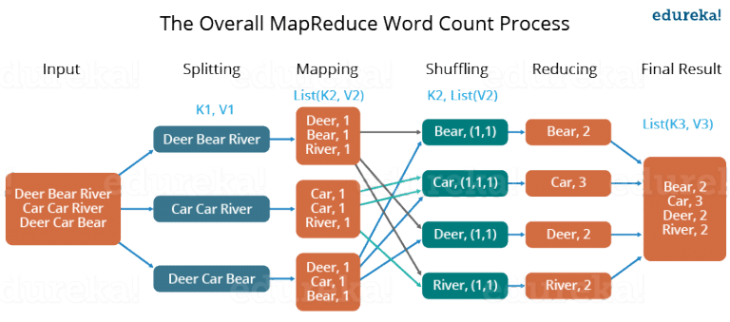
groupByKey()
https://medium.com/edureka/mapreduce-tutorial-3d9535ddbe7c

Slide 40
Transformation: groupByKey()
Create a KeyValueGroupedDataset from a Dataset using the groupByKey() transformation:
val byRole = people.groupByKey(p => p.role)
The byRole variable references a KeyValueGroupedDataset with key-value pairs of (role, person)

Slide 41
Three Useful Key-Value Operations
There are three particularly useful operations for key-value pairs:
count() – Counts the number of pairs with each unique key. Creates a KeyValueGroupedDataset with pairs of (key, Long)
mapGroups(f: (K, Iterator[V]): Re-arranges the pairs so that all values with the same key are together and runs the given function on each combination of key and associated values
mapValues(f: V): Like the regular map transformation but applied only to values

Slide 42
Dataset Example 2
https://github.com/rnowling/spark-examples/blob/main/src/main/scala/DatasetExample2.scala

Slide 43
Resources
Spark Dataset API docs: https://spark.apache.org/docs/latest/api/scala/org/apache/spark/sql/Dataset.html
Spark KeyValueGroupedDataset API docs: https://spark.apache.org/docs/latest/api/scala/org/apache/spark/sql/KeyValueGroupedDataset.html
Spark Examples: https://github.com/rnowling/spark-examples

Slide 44
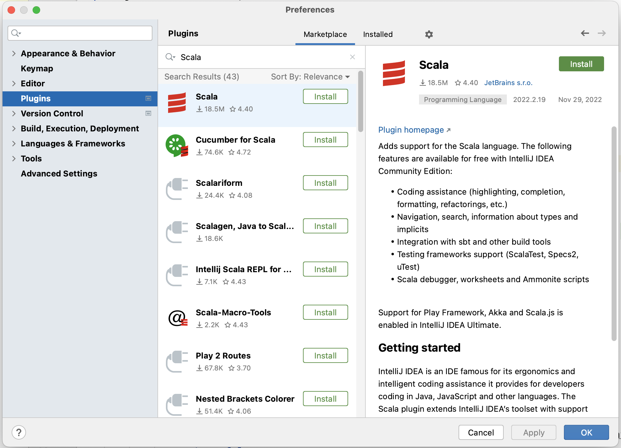
Install Scala Plugin

Slide 45
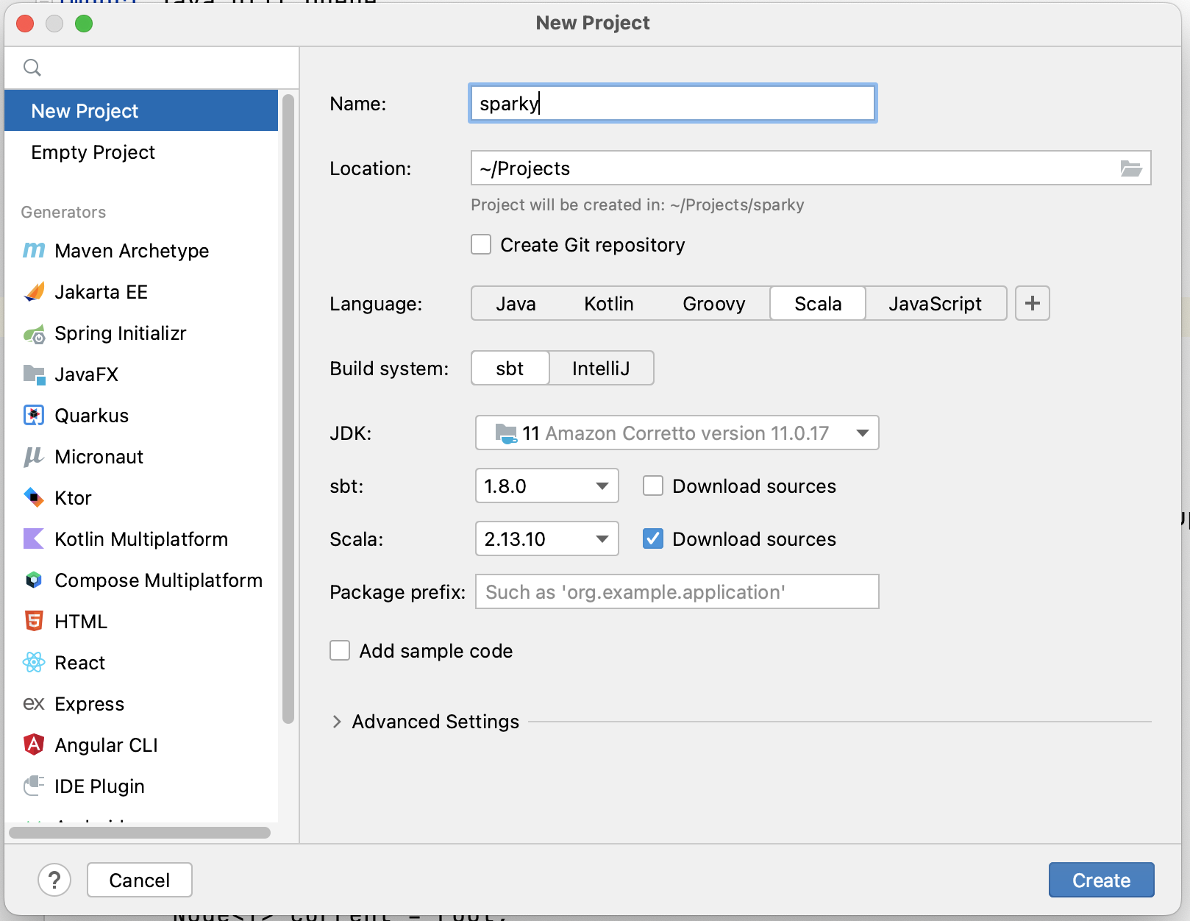
Create Scala Project

Slide 46
Create Scala Project

Slide 47
Create Scala Project

Slide 48
Create Scala Project

Slide 49
Create Scala Project

Slide 50
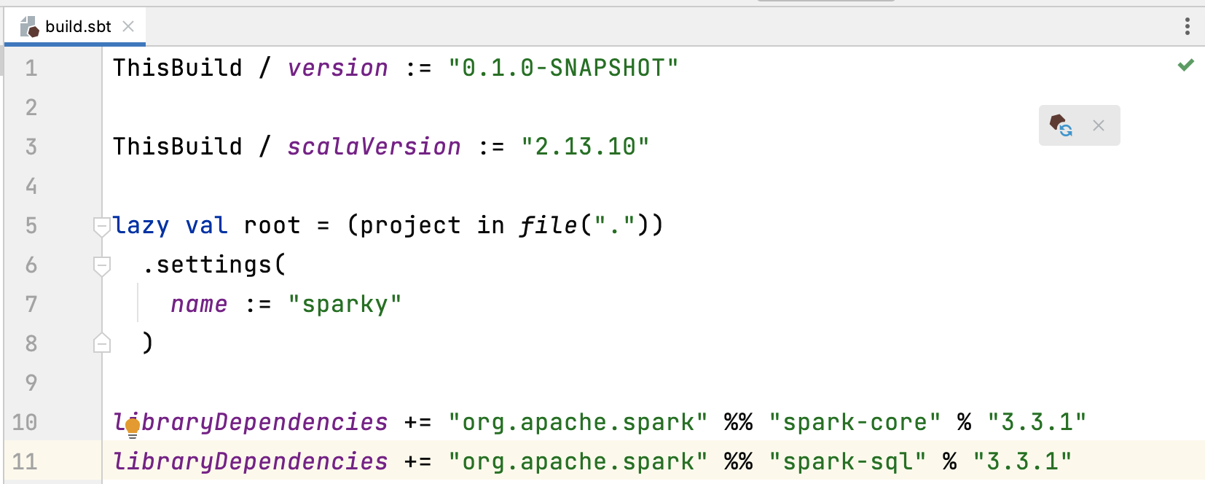
Add Dependencies to build.sbt

Slide 51
Add Dependencies to build.sbt

